Slide 1
Global Superstore Business Analysis: Better Business For Tomorrow
By:
Steven Fernandez, MD Miah, & Mohammed Hussain
Notes:
Script:
Hi. Today we are going to showcase how we can better our business for the future.
Next.

Slide 2
Content
The Problem Statement
Driving Profits
Shipping Inefficiencies & Customer Retention
Opportunities For Growth Summary
Notes:
Script:
For today's schedule, we are going to explore a few topics as listed. We are going first to introduce the problem statement to orientate how we went about understanding the problem at hand.
Then we are going to go into the analysis section, where we are going to provide the insights that we’ve found from the provided dataset. Within this, we will discuss how we plan to drive profits and how shipping inefficiencies might cost us our customer retention rate.
Lastly, we are going to wrap things up with a summary of the different opportunities for growth and the main points of action to take based on the insights we gathered.
Next.

Slide 3
The Problem Statement
I am looking to improve this year’s performance, what suggestions do you have for success?
What opportunities are there to increase profits and have better customer retention ?
Notes:
Script:
To start, we were given the following task to find opportunities for success to improve our upcoming years' performance.
We understood that the question was very ambiguous without a concrete direction. So we dissected the needs of the current situation and reframed the question based on what makes a business successful…
What opportunities are there to increase profits and have better customer retention?
Next.

Slide 4
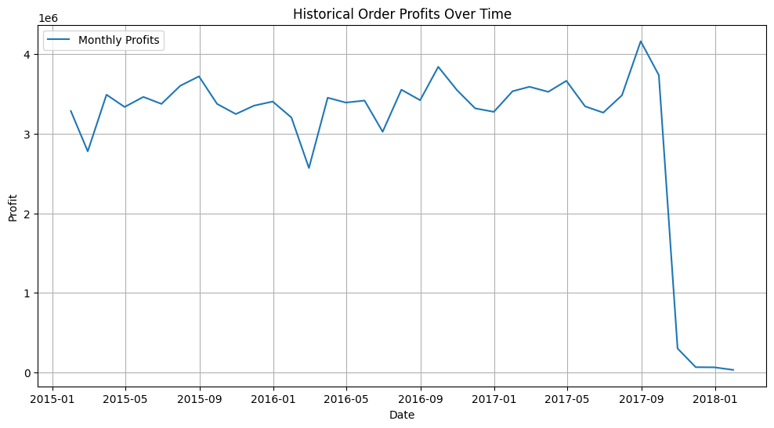
Analysis: Profit Trend
Massive drop in the profit trend starting late 2017 and leading into 2018
What happened ?

Slide 5
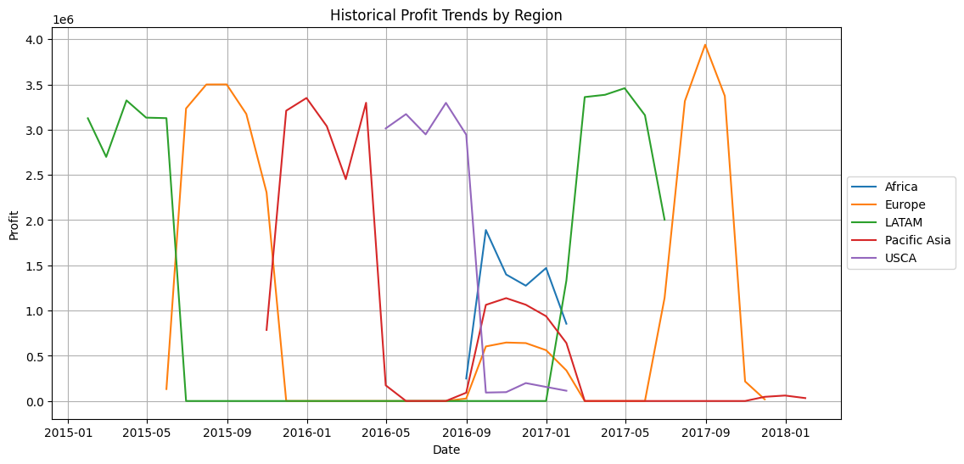
Analysis: Profit Trend by Region
The superstore doesn’t have a reliable source stream of profits
Profits comes from certain regions for a short period of time

Slide 6
How Can We Make This A Better Situation For The Superstore?

Slide 7
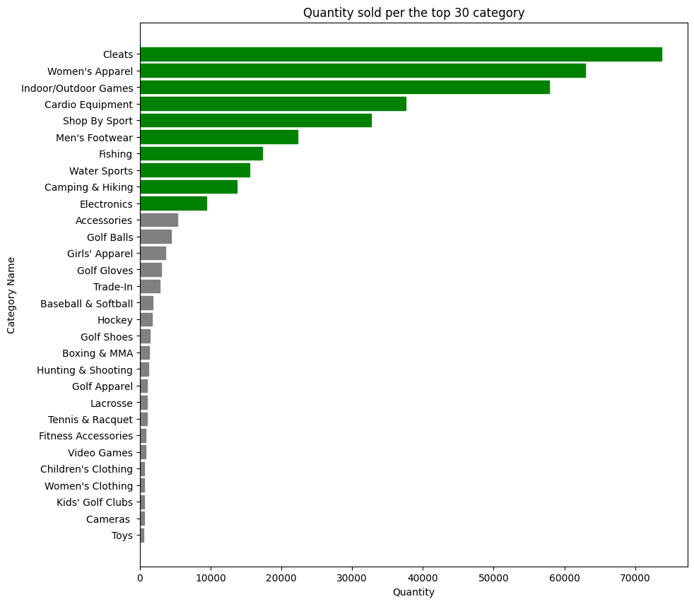
Analysis: Quantity Sold Per Product Category
The main products sold are based around sporting goods
Superstore should aim to focus the business around it

Slide 8
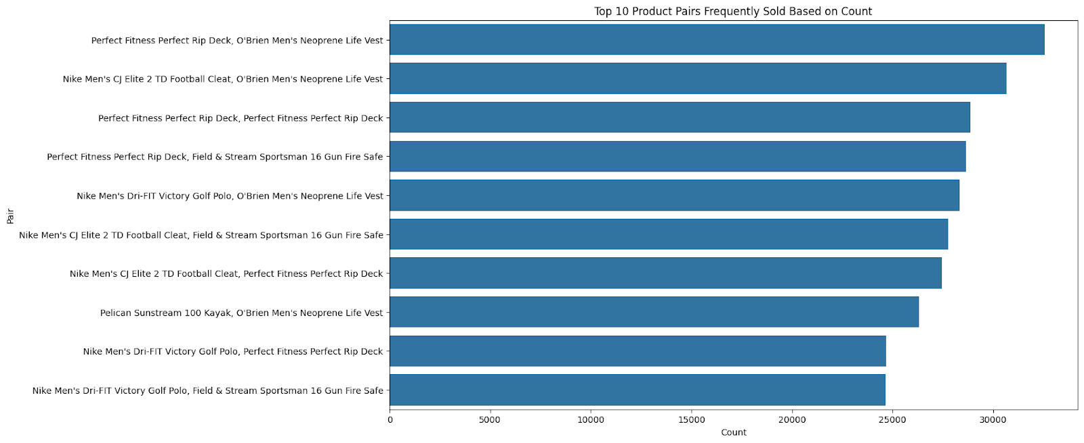
Analysis: Products Most Frequently In Pair

Slide 9
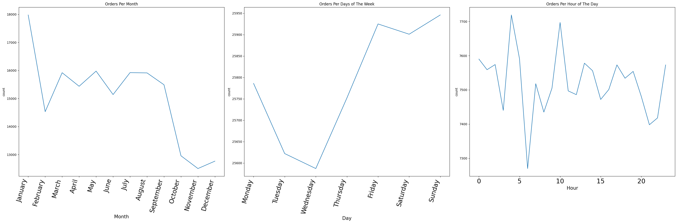
Marketing Analysis: Best Time for Ads (Based On When Most Of The Orders Are Made)
Month: Feb - Aug
Days: Wed – Sun
Hours: 3 – 4am & 9 – 11am

Slide 10
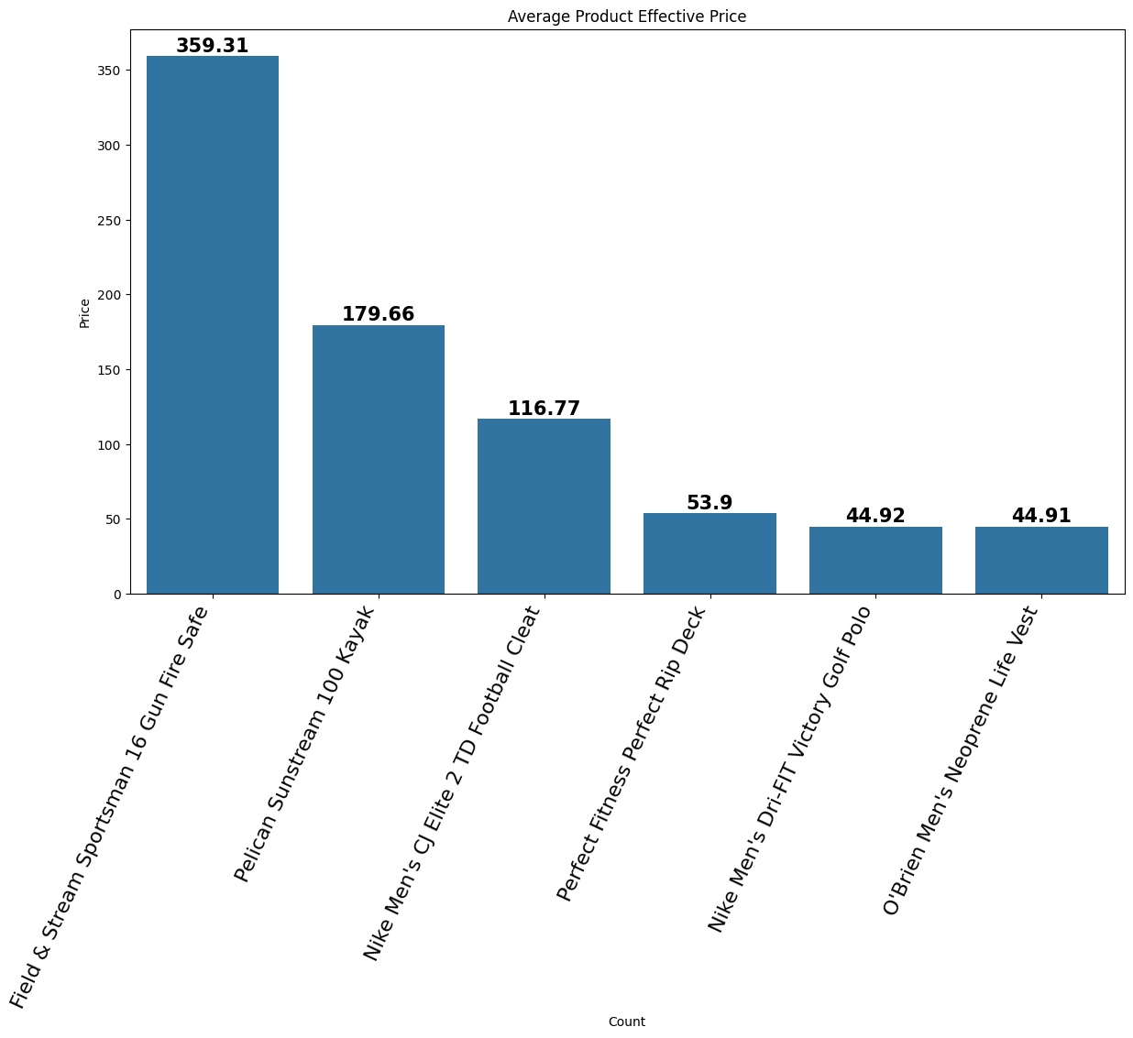
Effective Prices of Products

Slide 11
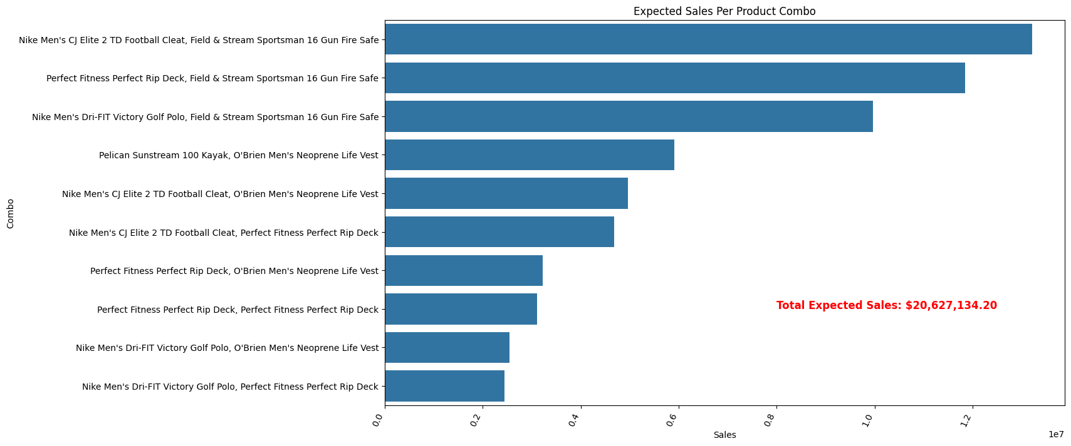
Product Combo Expected Sales

Slide 12
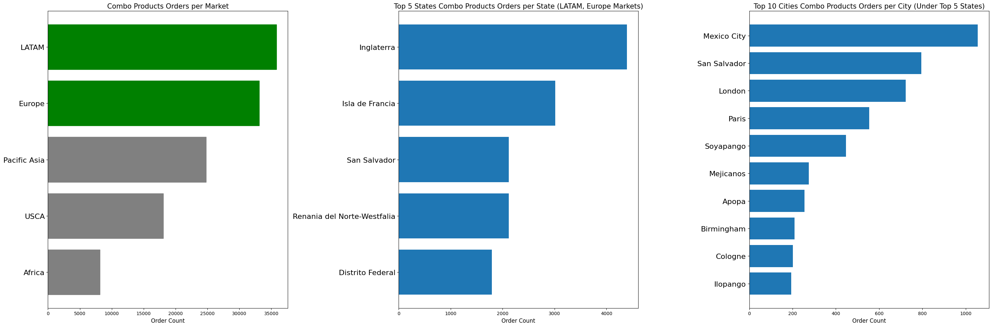
Best Places for The Combo Product (Based On Places With Top Orders)

Slide 13
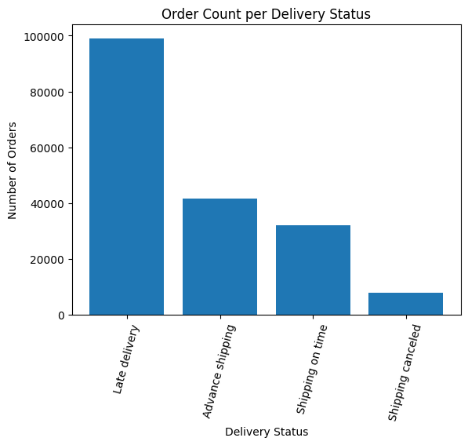
Analysis: Shipping Delivery Status
Most of the deliveries are late
Notes:
Script:
Going into the Shipping Delivery section of the presentation, we encountered a significant challenge. Our analysis has revealed that there was a consistent trend of late deliveries, a major concern that directly impacts customer trust and satisfaction. It's not just an operational issue; it reflects our commitment to service excellence. We need to delve into the reasons behind these delays, whether they're due to logistic challenges, supplier inefficiencies, or internal procedural gaps.

Slide 14
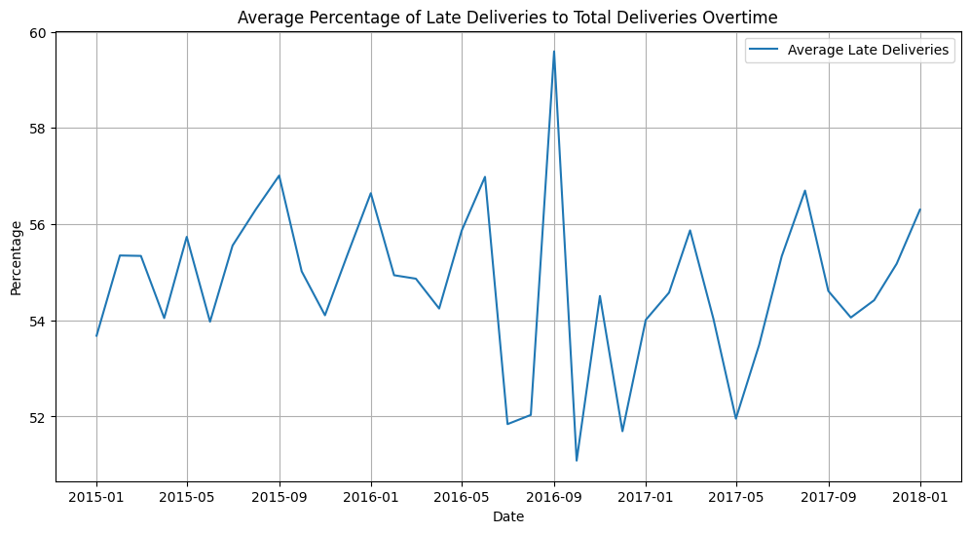
Analysis: Average Percentage of Late Deliveries
Alarming 50% + of our deliveries are late for the past three years
Notes:
Script:
In a more detailed analysis, a disturbing trend emerges. Over the last three years, more than half of our deliveries have been late. This level of inefficiency is far beyond acceptable thresholds and necessitates a thorough review of our entire delivery chain. It's imperative to identify the contributing factors and develop a robust plan to address these shortcomings.

Slide 15
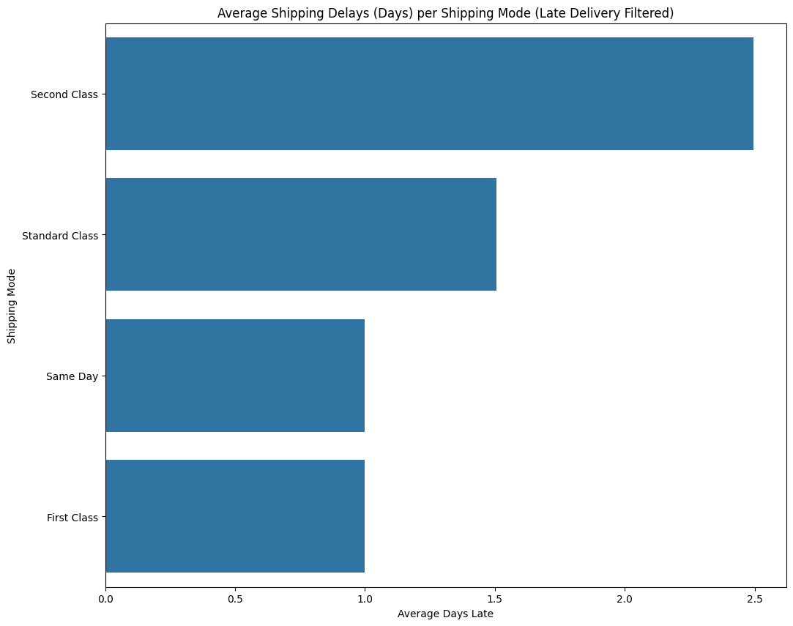
Analysis: Shipping Delay Days By Shipping Mode
On average second class and standard class are the shipping modes that are mostly delivered late
Reach to our shipping provider to negotiate terms or optimize our shipping modes internal processes
Notes:
Script:
Further examination of our shipping delays reveals that specific shipping modes, particularly the second class and standard class, are frequently encountering issues. This insight is critical for renegotiating terms with our shipping providers and enhancing our logistical frameworks. Improving these aspects will not only reduce delays but also bolster our overall shipping efficiency.

Slide 16
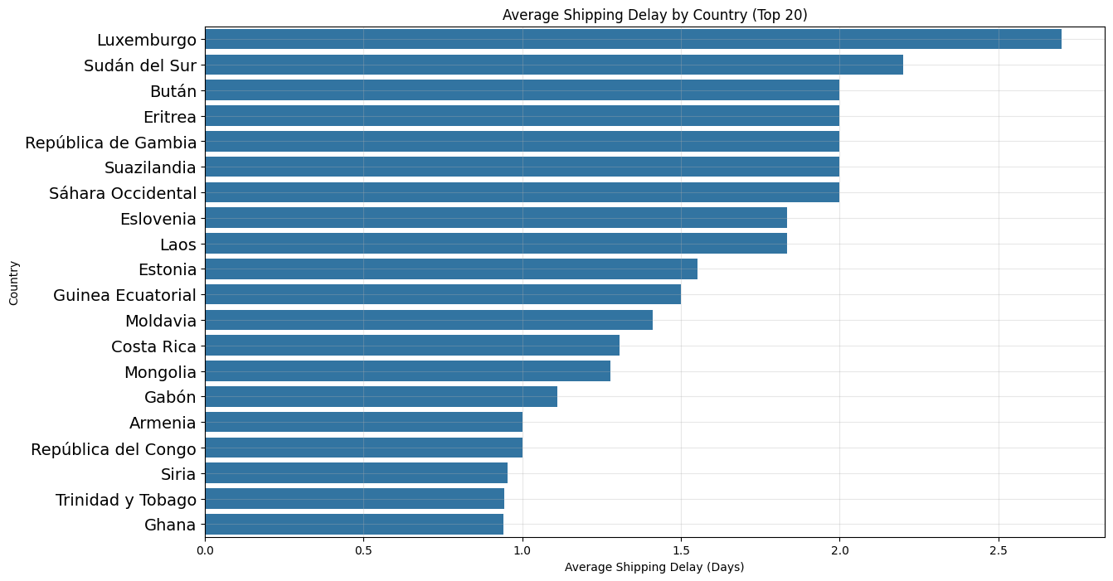
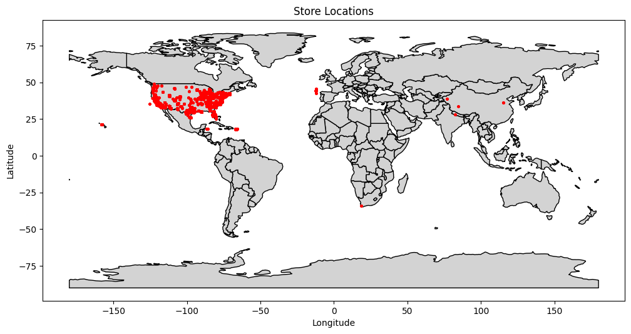
Analysis: Store Location & Countries With Highest Average Shipping Delays (Days)
Notes:
Script:
Our geographical analysis brings to light that our store locations are in the US and countries that are experiencing higher-than-average shipping delays are located in more remote areas of Africa and Pacific Asia. This is a vital piece of information for developing region-specific strategies. By addressing these geographical disparities, such as providing quotas to determine if the business in those areas is profitable enough to keep doing business or further investigation into internal and external shipping logistics for those areas, we can achieve a more balanced and efficient shipping process. However, we need more data related to those fields to do further analysis

Slide 17
Summary: Opportunities For Growth
Sell the most in-demand products and target customers by creating smart-deal marketing products
1
Improve our late deliveries
2
Increase the expected delivery days for each shipping mode
Reach out to our shipping provider to negotiate terms
Survey our internal processes to optimize
Notes:
Script:
As we conclude our analysis of store locations and the countries facing the highest average shipping delays, it becomes evident that adaptation and innovation are needed for our growth.
First, we have identified a critical path for aligning our product portfolio with market demand. This business decision is a commitment to understanding and fulfilling the evolving needs of our customers. Therefore, our marketing strategies will be smarter and more targeted, ensuring that we not only reach our audience but also resonate with them.
Second, the issue of shipping delays has been a significant concern. We recognize the necessity of improving the delivery efficiency. So to fix this, we can recalibrate our delivery timelines, engage in constructive negotiations with shipping partners, and refine our internal logistics. By doing this, we can transform this challenge into an opportunity to build customer trust and satisfaction…
All in all, these strategies reflect our commitment to excellence and customer-centric growth. And with your support, they can be tangible successes.
Next.

Slide 18
Thank You!
We Look Forward To Working With You…

